Slide 1
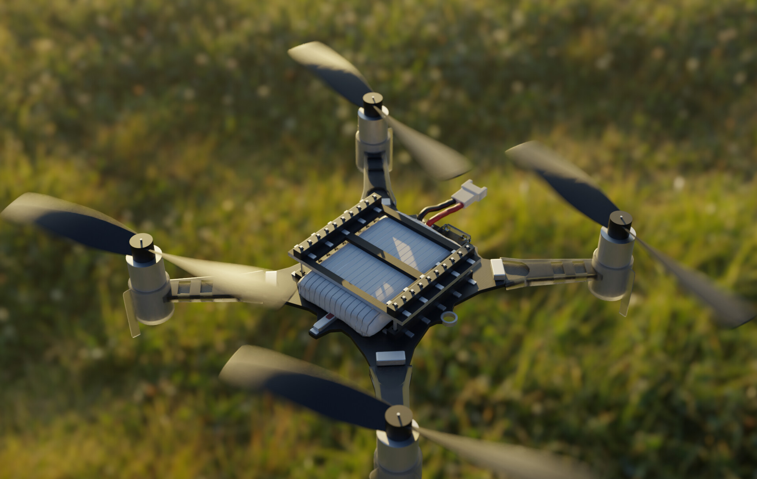
Aerial Robotics - Hardware project
Kento Jousson
Marie Ethvignot
Charles Girardot
Samuel Desmurs
Group 14
MICRO-502

Slide 2
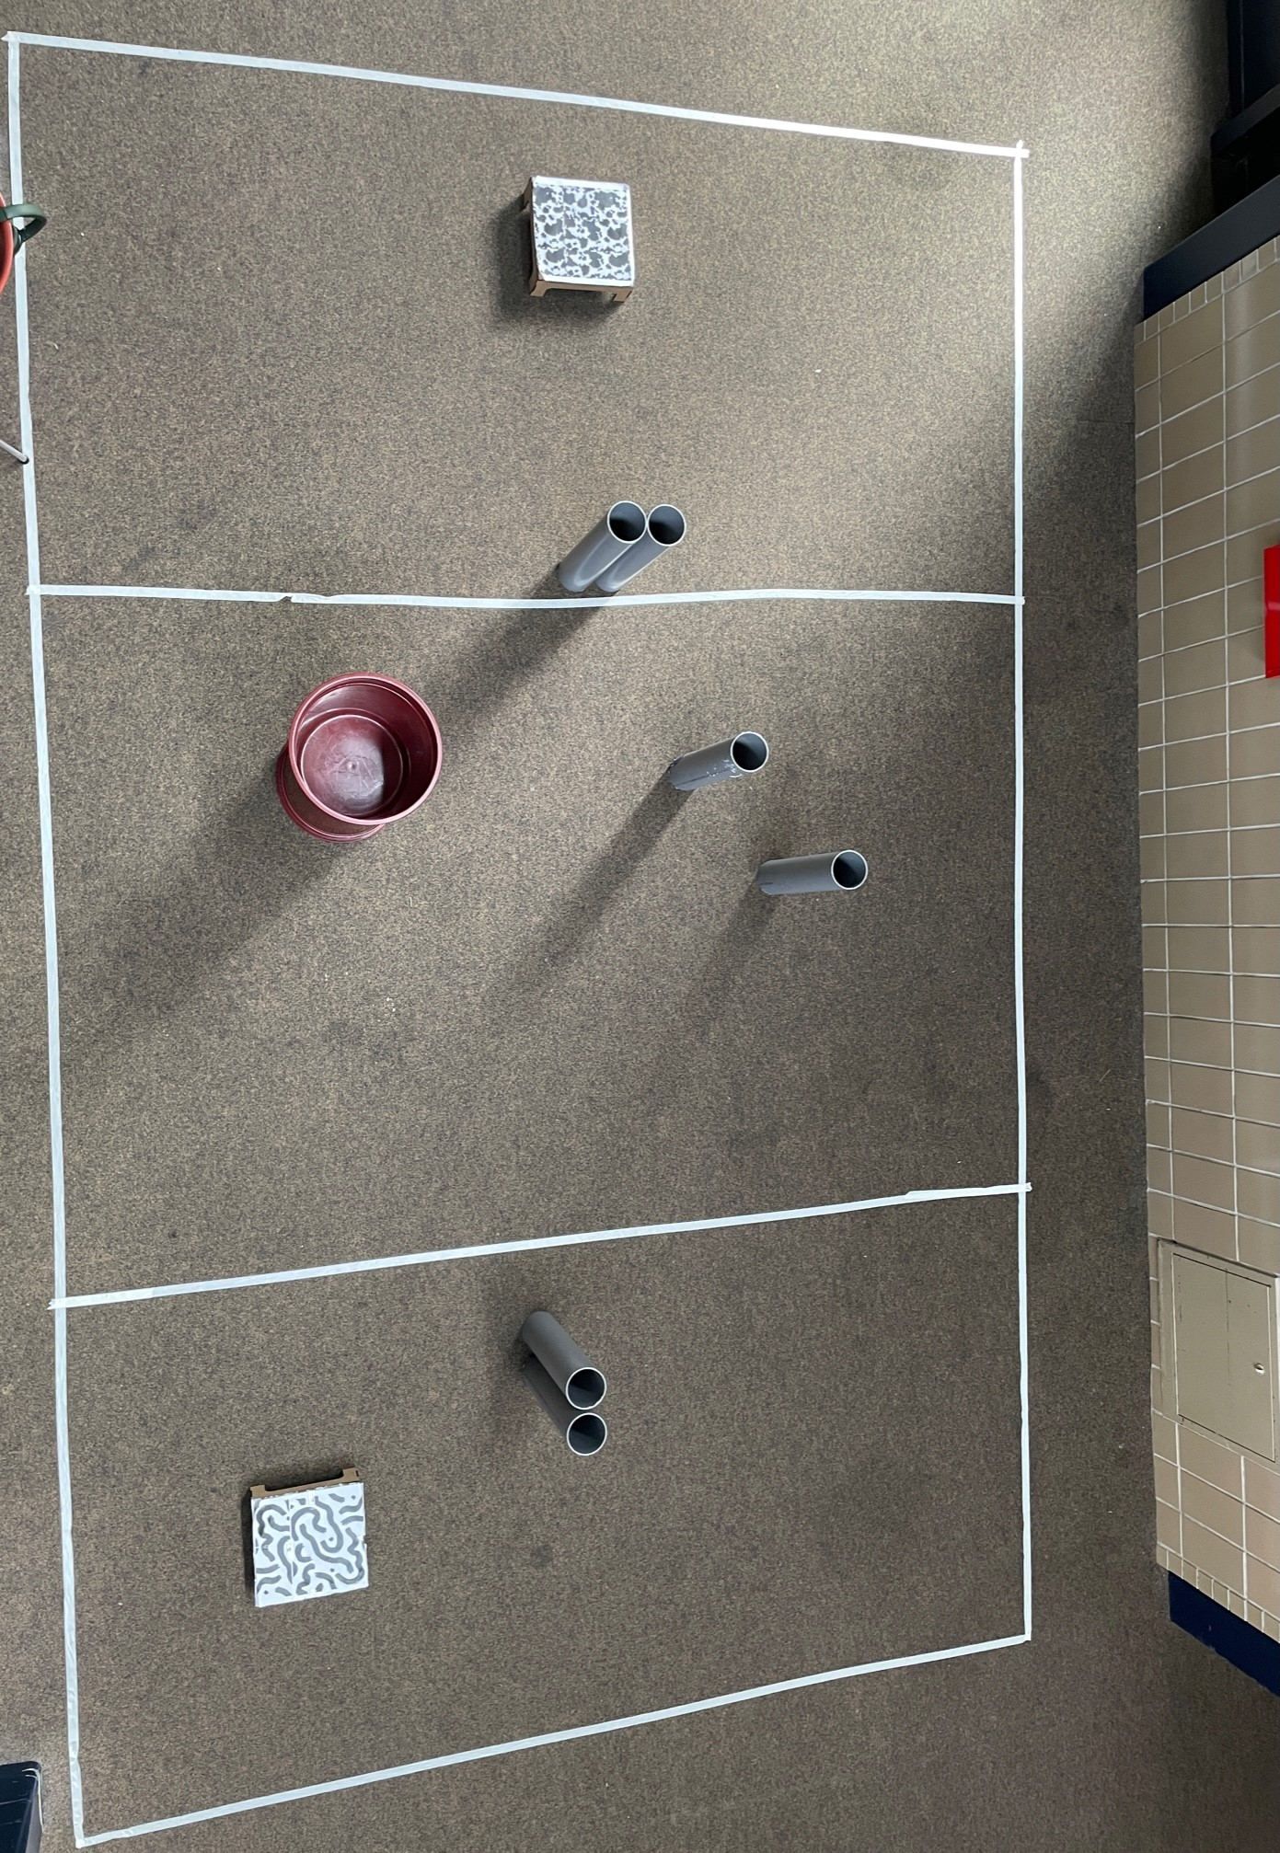
Experimental setup
How we built our setup to test our crazyflie hardware project

Slide 3
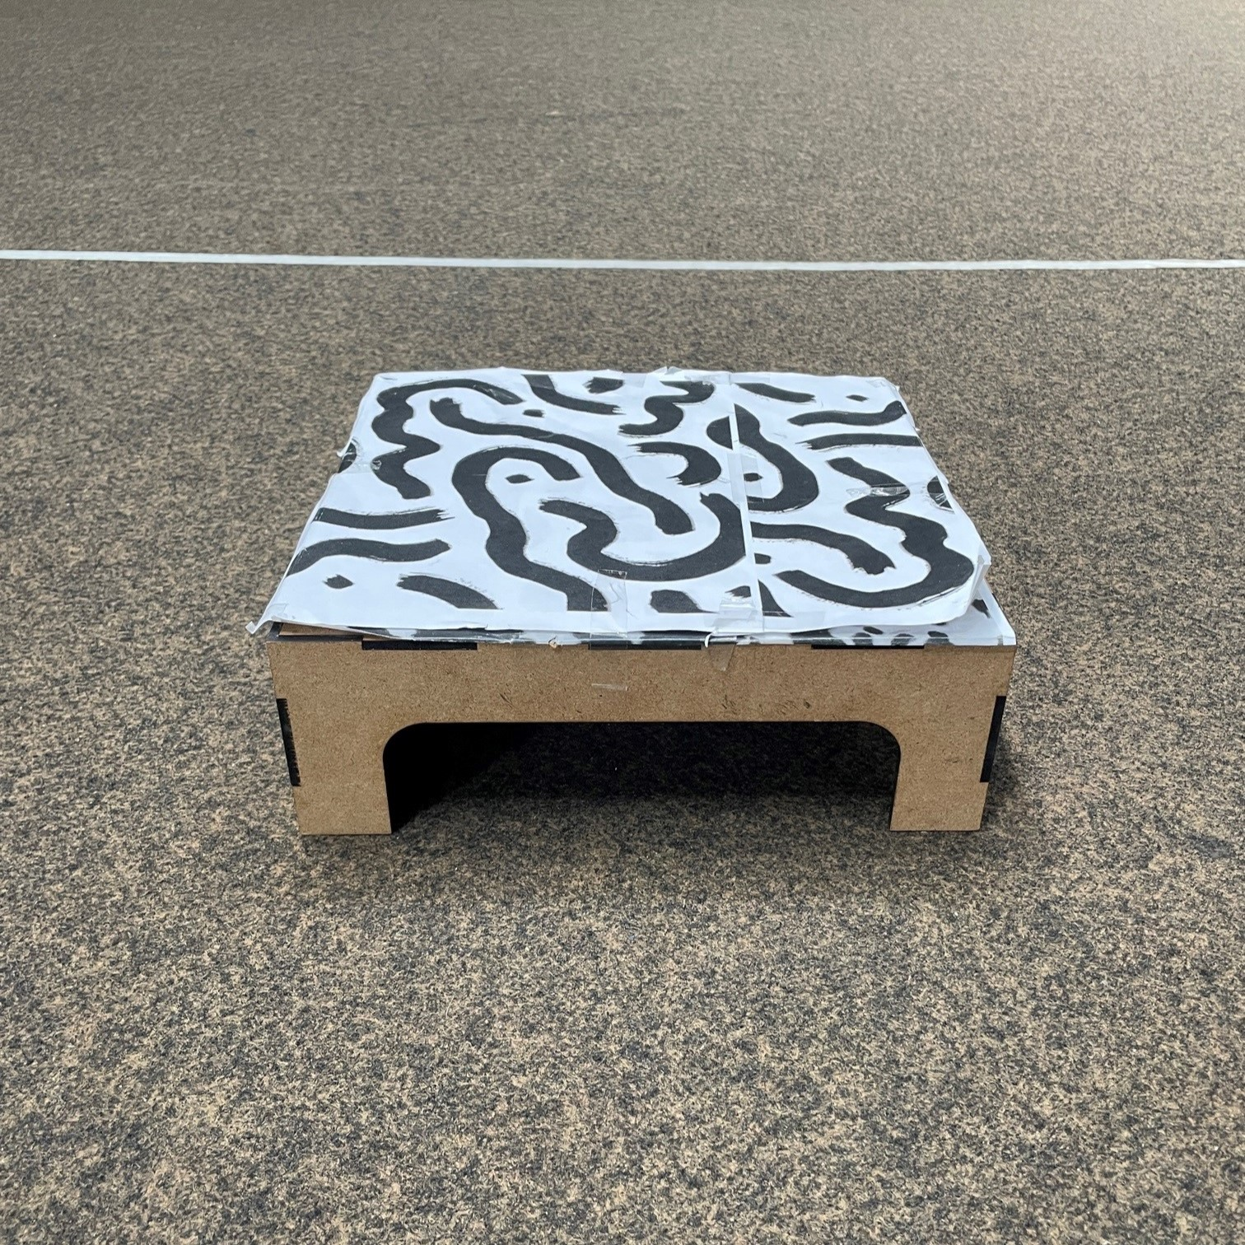
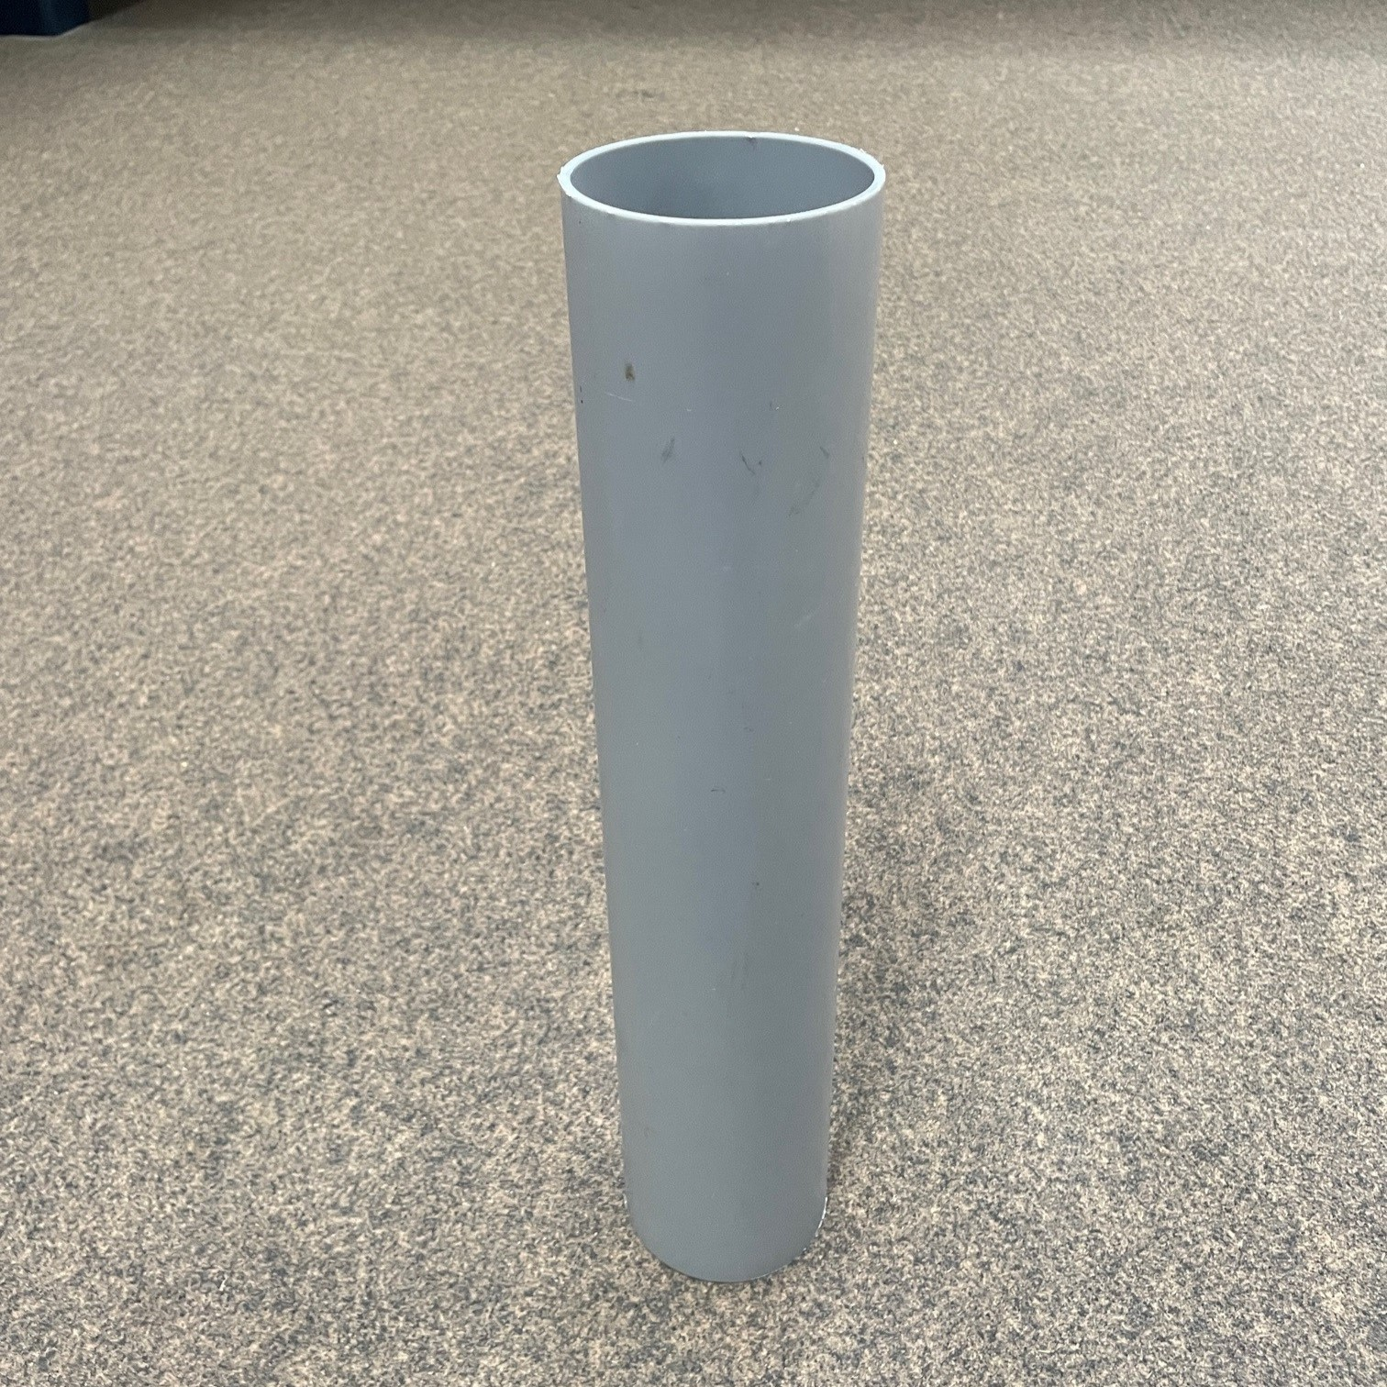
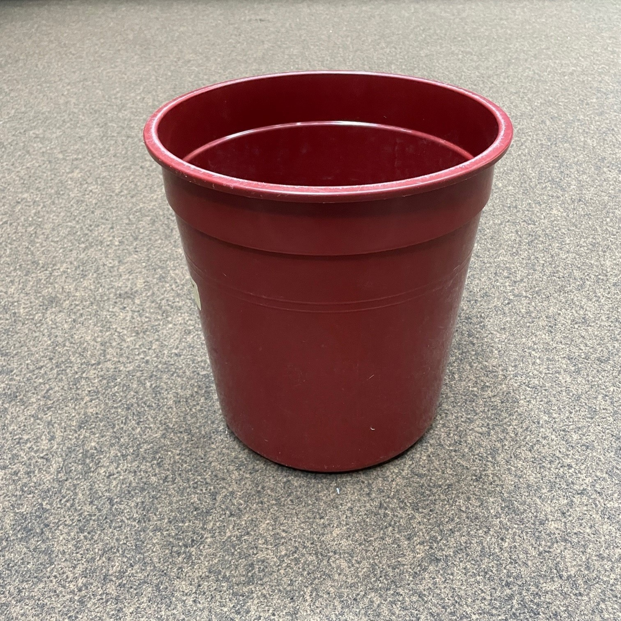
Experimental setup
Pads
Small obstacle
The Pads are made from laser-cut MDF
The small obstacles are made of cut PVC tubes
The large obstacles are simple plastic bins
In the end, we didn't use a pattern because the floor of the ELA building had enough patterns
Big obstacle

Slide 4
Strategy
Flight forward: Fly to the landing zone with occasional left and right movements to enhance obstacle detection.
Grid search in the landing zone: Perform a snake-type grid search with occasional back and forth movements to enhance obstacle detection.
Landing on the pad: Detect a change in altitude ('range_down') and progressively land in that direction.
Flight back: Align in the direction of the take-off pad followed by a straight line flight towards it.
Landing on the detected and memorized take-off pad.

Slide 5
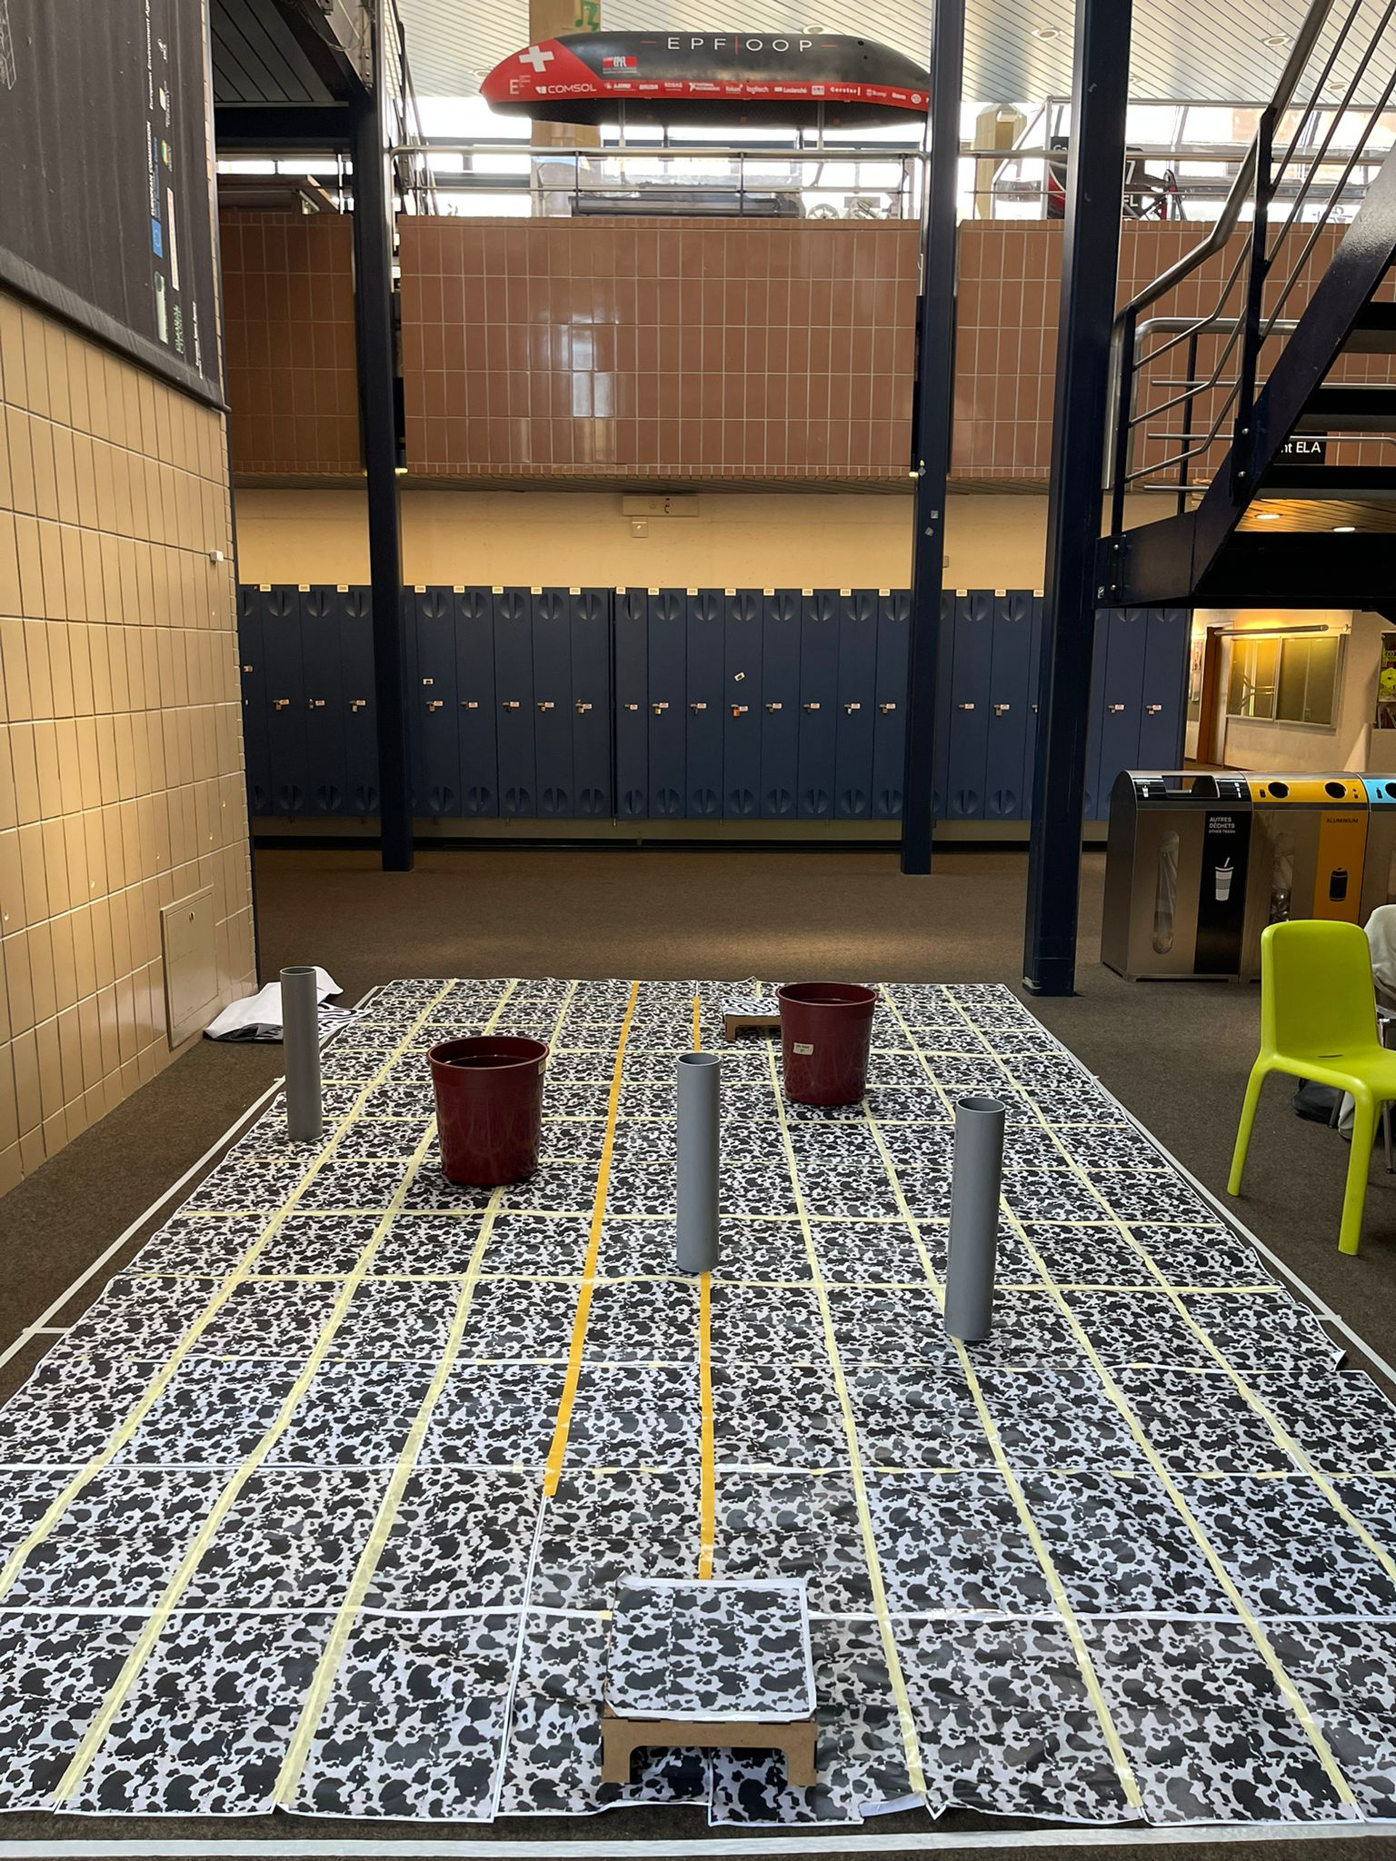

Results
Missions almost always successful (sometimes landing back on take-off pad is not achieved drift in Kalman filter)
Average mission time: 1min20 ± 20secs (depending on the position of the landing pad)

